Slide 1
AI Chat Bots
https://jimfawcett.github.io/NewSite/Code/CodeBites_ChatBotAI.html
Jim Fawcett & Mike Corley
January 9th, 2026
Notes:
Generated by Copilot Hello and welcome to the first of three videos about using AI for software development. In this first video Mike and I will talk about using AI chat bots.
The URL offers additional resources and code examples related to AI chat bots.
______

Slide 2
Introduction
AI can help make software development more productive:
Write unit tests for existing libraries
Create small code analysis tools
Find and explain bits of code syntax
List library public interfaces
Explain how third-party code works
Help you learn languages and libraries
More …
Each video describes an AI facility, e.g., web app, agent, console
Provides an example of how that may be used to support dev work.
Notes:
Generated by Copilot AI can improve software development productivity by automating tasks, e.g., writing unit tests, analyzing code, and explaining syntax. Each video in this series highlights a specific AI tool, demonstrating useful ways AI supports development workflows.
______

Slide 3
Background
Many AI platforms, e.g., OpenAI, Anthropic, Gemini, … have at least three ways of interacting with a Large Language Model (LLM):
Chat Bot web application (topic of this presentation)
Can’t read from or write to local repositories
Can’t read code from github repository
Can paste a zip with code at the end of a prompt
Agent (topic of 2nd presentation)
Uses local code application to communicate with LLM
Can read from and write to local repositories
Console (topic of 3rd presentation)
Like agent but you don’t have to write agent code
You simply use the console
Notes:
Generated by Copilot There are three main ways to interact with Large Language Models (LLMs) across various AI platforms: chat bot web apps, agents, and consoles. Chat bots provide a web interface but have limited access to local or GitHub repositories. Agents integrate with local applications and can read and write to local repositories. Consoles offer similar capabilities to agents but without requiring custom agent code, making them more accessible for developers.
______

Slide 4
Chat Bots
Chat Bots are web applications consisting of:
Browser-based interface that accepts prompts and displays results
A containerized pre-trained Large Language Model (LLM) running in a Linux server in a data center
Https-based communication infrastructure to ferry prompts to, and results from the LLM
Notes:
Generated by Copilot Chat bots operate as web applications with a browser-based interface for user prompts and responses. They rely on containerized, pre-trained LLMs hosted on Linux servers in data centers. Communication between the user and the LLM happens over secure HTTPS connections, enabling prompt delivery and response retrieval.
______

Slide 5
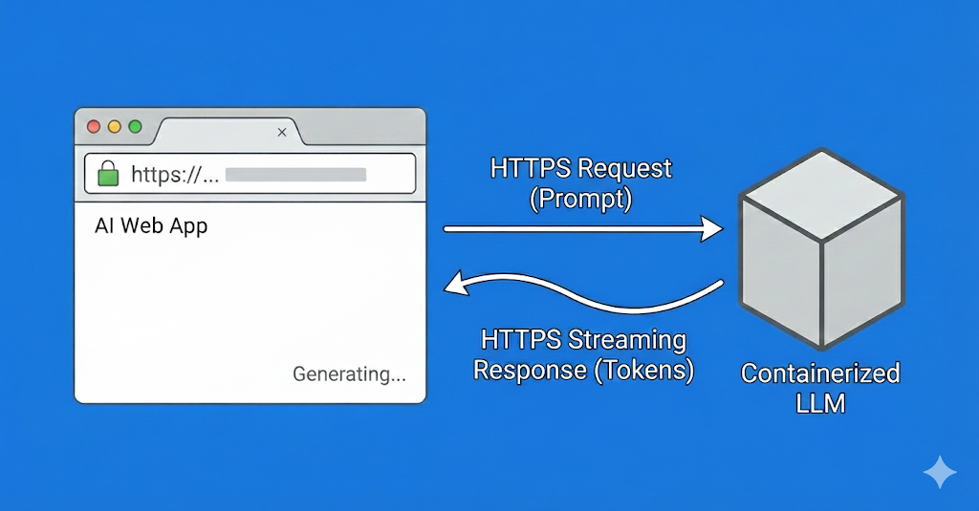
AI Web App Structure
Notes:
Generated by Copilot This diagram illustrates the architecture of an AI web application, showing how the user interface, server hosting the LLM, and communication protocols interact. It is intended to clarify how chat bots process requests and deliver AI-generated responses efficiently.
The diagram was generated by Gemini nano banana.
______

Slide 6
Limitations
AI Chat Bots have web application limitations:
Cannot read from or write to local repositories
Cannot read files from github repository
Notes:
Generated by Copilot AI chat bots have inherent limitations due to their web-based nature. They cannot directly access or modify local code repositories or read files from GitHub. This restricts their ability to interact with a developer's full codebase, which is important to consider when planning use of these tools.
______

Slide 7
Work Arounds
You can paste code text at the end of a prompt
Prompt specifies what to do with the following code
You can create a zip for a local repository or download a github zip
Paste zip file at the end of a prompt
You can request Chat Bot to download its results to your local download directory
Notes:
Generated by Copilot To overcome chat bots' access limitations, users can paste code snippets or entire zipped repositories directly into prompts. This allows the LLM to analyze the provided code. Additionally, chat bots can be instructed to download their output to the user's local system, making it easier to integrate AI-generated responses with build documentation.
______

Slide 8
Example – Size and Complexity of code functions
This prompt:
“Generate a list of function line counts and complexities for all functions in the zip file pasted at end of this prompt. Line count is total number of lines including code, whitespace, comments Complexity is the number of open braces in each function”
AI Generated a list of all the functions with correct line counts and complexities for a Rust Thread Pool.
Note: Rust code is easier to parse than C++ and doesn’t have function overloads.
Notes:
Generated by Copilot The example prompt requests the AI to analyze a zipped Rust thread pool codebase, generating a list of functions with their line counts and complexity metrics based on open braces. Rust's syntax simplicity compared to C++ makes it easier for the AI to parse and analyze, demonstrating practical code analysis capabilities of AI chat bots.
______

Slide 9
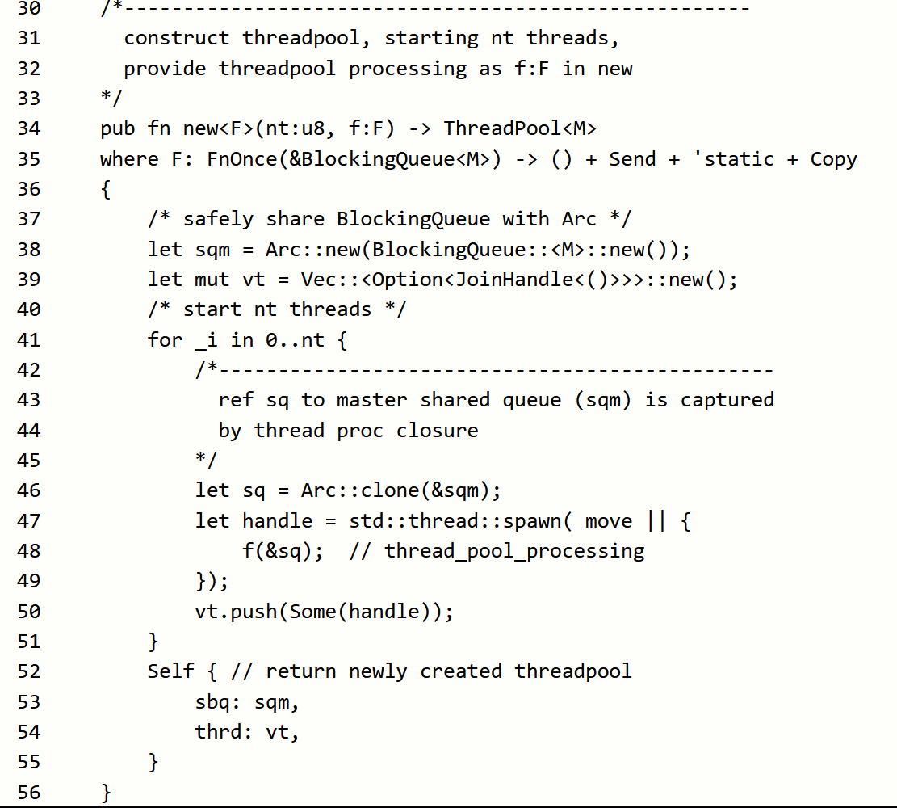
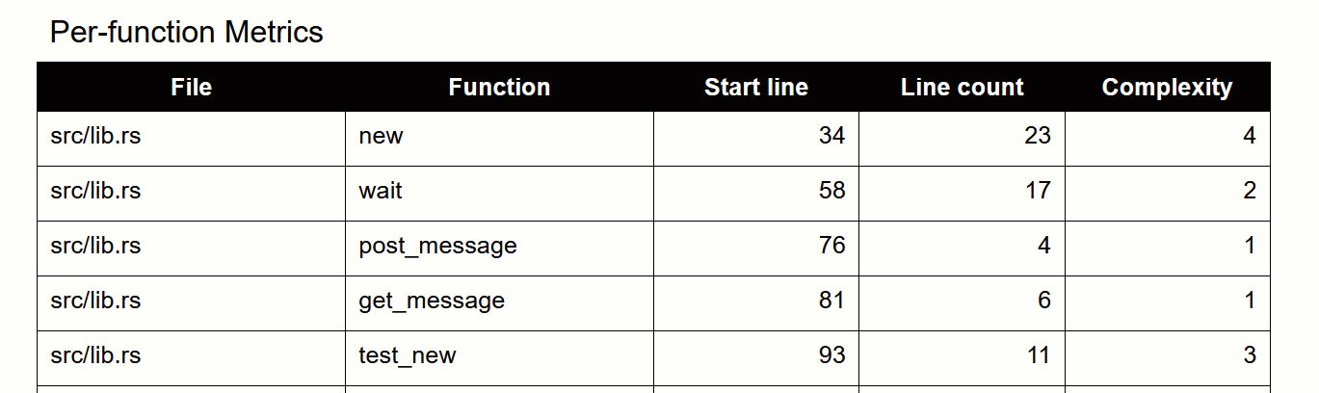
Partial Code and Analysis Results
Notes:
Generated by Copilot Here is a sample of the AI-generated analysis results, showing function names, line counts and complexity scores. Such output helps developers assess code structure and identify complex or lengthy functions that may need refactoring.
______

Slide 10
Conclusion
You can find all the details here: https://jimfawcett.github.io/NewSite/Code/CodeBites_ChatBotAI.html
The next presentation explores:
AI Agents
Use local application to communicate with the LLM
Uses HTTPS-based API
Can read from and write to local file system
The one after that explores:
AI Consoles
Have access to local repositories
Don’t need to write Agent code
Notes:
Generated by Copilot For more detailed information, click the URL.
Upcoming presentations will explore AI agents, which interact with local applications and file systems via HTTPS APIs, and AI consoles, which offer repository access without requiring agent code.
______

Slide 11
End of Presentation
Notes:
Generated by Copilot This marks the end of the presentation. It provides a moment to recap key points and invite any final questions or discussions before concluding the session.
______

